Slide 1
OSCILLATOR OPERATION
Lecture 10
page

Slide 2
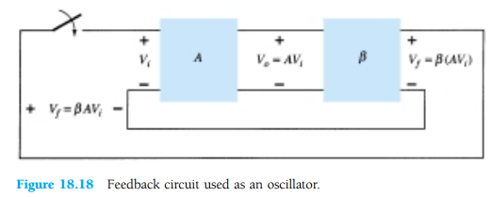
OSCILLATOR OPERATION
The use of positive feedback that results in a feedback amplifier having closed-loop gain |Af| greater than 1 and satisfies the phase conditions will result in operation as an oscillator circuit.
An oscillator circuit then provides a varying output signal.
If the output signal varies sinusoidally, the circuit is referred to as a sinusoidal oscillator.
If the output voltage rises quickly to one voltage level and later drops quickly to another voltage level, the circuit is generally referred to as a pulse or square-wave oscillator.

Slide 3
Fig. 18.18, When the switch at the amplifier input is open, no oscillation occurs. Consider that we have a imaginary voltage at the amplifier input (Vi).
This results in an output voltage Vo = AVi after the amplifier stage and in a voltage
Vf =β(AVi) after the feedback stage.
where βA is referred to as the loop gain.
the base amplifier and feedback network provide βA of a correct magnitude and phase,
Vf can be made equal to Vi
when the switch is closed and imaginary voltage Vi is removed
circuit will continue operating (the feedback voltage is sufficient to drive the amplifier)
and feedback circuits resulting in a proper input voltage to sustain the loop operation.

Slide 4
Barkhausen criterionfor oscillation
The output waveform will still exist after the switch is closed if the condition is met βA=1
This is known as the Barkhausen criterionfor oscillation.
In reality, no input signal is needed to start the oscillator going. Only the condition βA=1 must be satisfied for self-sustained oscillations to result.
In practice,βA > 1
system is started oscillating by amplifying noise voltage.
The resulting waveforms are never exactly sinusoidal.
the closer the value βAis to exactly 1, the more nearly sinusoidal is the waveform.

Slide 5
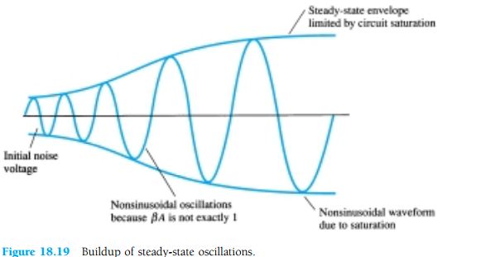
Figure 18.19 shows how the noise signal results in a buildup of a steady-state oscillation condition
Another way of seeing as an oscillator by basic feedback equation :
Af =A/(1+βA). When βA = -1 or magnitude 1 at a phase angle of 180°,
so, Af = infinite.
an infinitesimal signal (noise voltage) can provide a measurable output voltage, and the circuit acts as an oscillator even without an input signal.

Slide 6
PHASE-SHIFT OSCILLATOR
An example of an oscillator circuit
An idealized version of this circuit is shown inFig. 18.20.
For oscillation must βA> 1
phase shift around the feedback network is 180°(providing positive feedback).
We are considering by a perfect source (zero source impedance)
and the output of the feedback network connected with perfect load (infinite load impedance).
Practical circuit versions will then be considered.

Slide 7
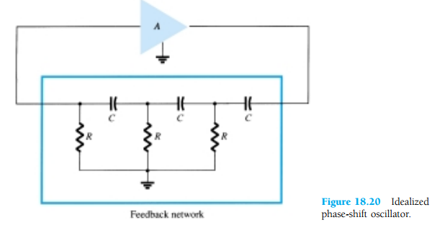
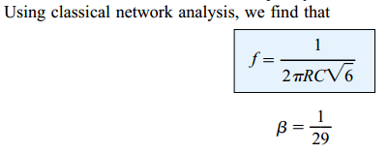
and the phase shift is 180°.
For the loop gain βA >1
So, A > 20

Slide 8
the values of R and C to provide (at a specific frequency) 60°-phase shift per section for three sections, resulting in a 180°phase shift, as desired.
The net result that the total phase shift be 180°is all that is important.
If one measured would not provide the same phase shift
(overall phase shift is 180°).
If it were desired to obtain exactly a 60°phase shift for each of three stages, then emitter-follower stages would be needed for each RC section to prevent each from being loaded from the following circuit.

Slide 9
FET Phase-Shift Oscillator
The amplifier stage is self-biased with a capacitor bypassed source resistor RS and a drain bias resistor RD. The FET device parameters of interest are gm and rd.
amplifier gain magnitude is calculated from

Slide 10
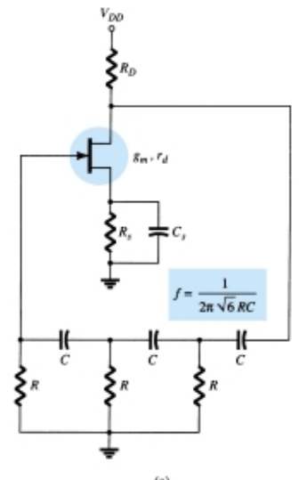
Figure 18.21 Practical phase-shift oscillator circuits: (a) FET version

Slide 11
assume as a very good approximation: input impedance (FET) = infinite.
This assumption is valid as long as the oscillator operating
frequency is low : then capacitive impedances neglected.
The output impedance is small compared to the impedance seen looking into the feedback network so that no attenuation due to loading occurs.
In practice, these considerations are not always negligible, and the
amplifier stage gain is then selected some what larger than the needed factor of 29 to assure oscillator action.

Slide 12
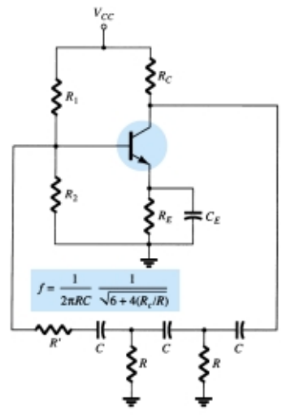
Transistor Phase-Shift Oscillator
Fig. 18.21 Practical phase-shift
oscillator circuits:
b) BJT version.
transistor as (active element),
an emitter-follower first stage.
common-emitter amplifier second stage.
If a single transistor stage is desired, the use of voltage-shunt feedback (as shown in Fig. 18.21b) is more suitable.
the feedback signal is coupled through the feedback resistor R′ in series with the amplifier stage input resistance (Ri).

Slide 13
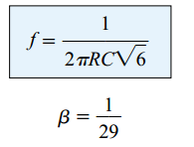
IC Phase-Shift Oscillator

Slide 14
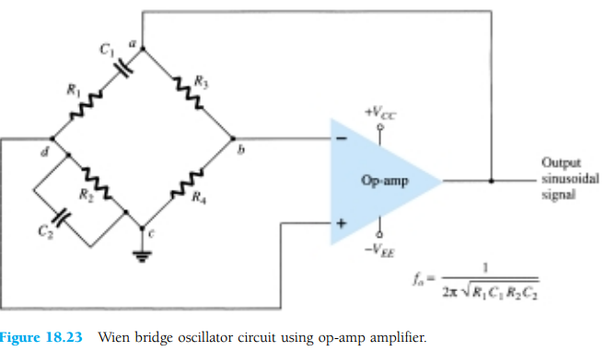
WIEN BRIDGE OSCILLATOR
Resistors R1 and R2 and capacitors C1 and C2 form the frequency-adjustment elements,
while resistors R3 and R4 form part of the feedback path.
The op-amp output is connected as the bridge input at points a and c.
The bridge circuit output at points b and d is the input to the op-amp.

Slide 15
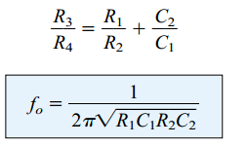
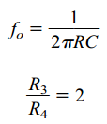
Neglecting loading effects of the op-amp input and output impedances, the analysis of the bridge circuit results in
If, in particular, the values are R1= R2 = R and C1 = C2 = C, the resulting oscillator frequency is
provide sufficient loop gain for the circuit
to oscillate at the frequency

Slide 16
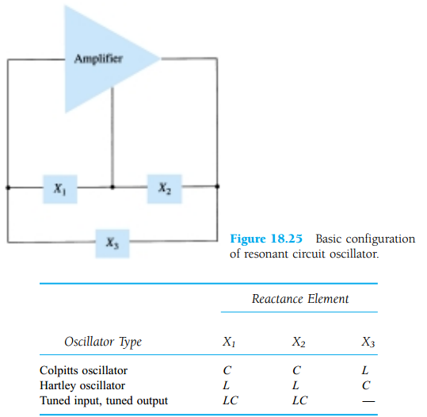
TUNED OSCILLATOR CIRCUIT Tuned-Input, Tuned-Output Oscillator Circuits

Slide 17
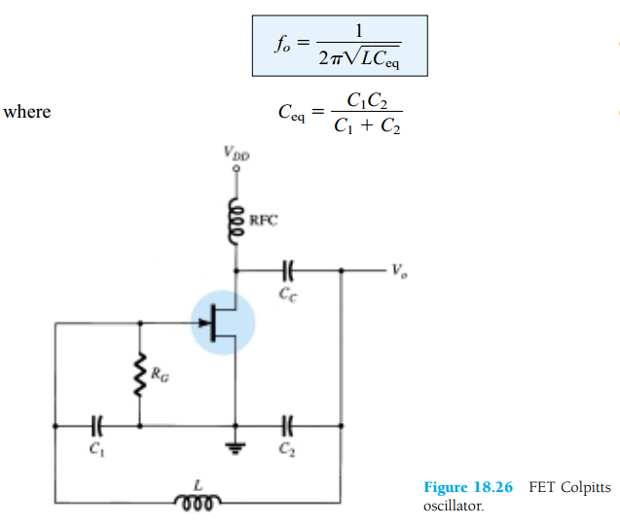
Colpitts Oscillator FET COLPITTS OSCILLATOR
The oscillator frequency can be found
to be

Slide 18
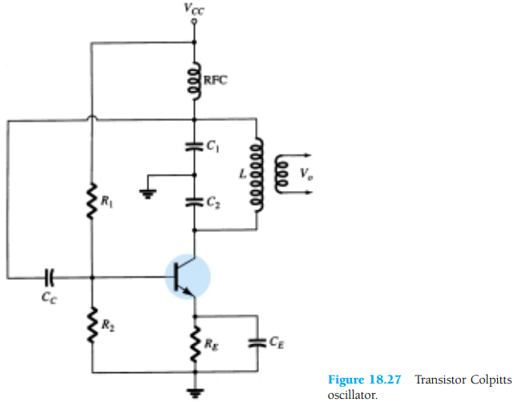
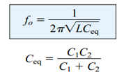
TRANSISTOR COLPITTS OSCILLATOR

Slide 19
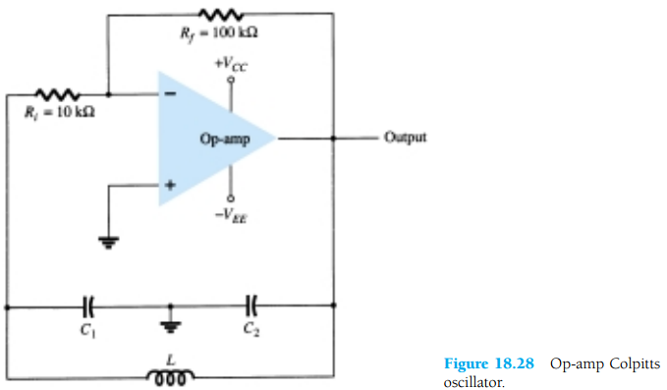
IC COLPITTS OSCILLATOR

Slide 20
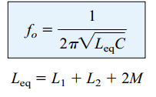
Hartley Oscillator
If the elements in the basic resonant circuit of Fig. 18.25 are X1 and X2 (inductors) and X3 (capacitor), the circuit is a Hartley oscillator
FET HARTLEY OSCILLATOR
that inductors L1 and L2 have a mutual coupling, M,which must be taken into account in determining the equivalent inductance for the resonant tank circuit.
The circuit frequency of oscillation is then given approximately by

Slide 21
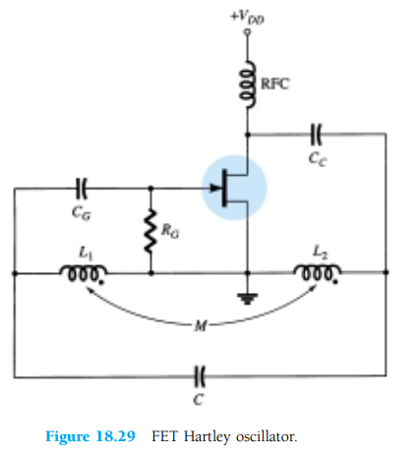

Slide 22
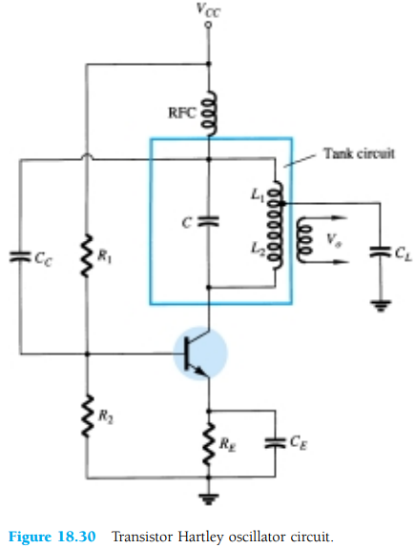
TRANSISTOR HARTLEY OSCILLATOR

Slide 23
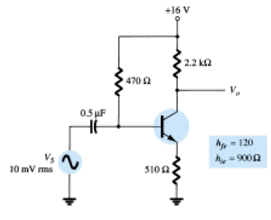
For a circuit as in Fig. below and the following circuit values, calculate the circuit gain and the input and output impedances with and without feedback: RB 650 kohm, RE = 1.4 kohm, RC= 4 = kohm, and β= 75. Use VCC 16 V.

